Slide 1
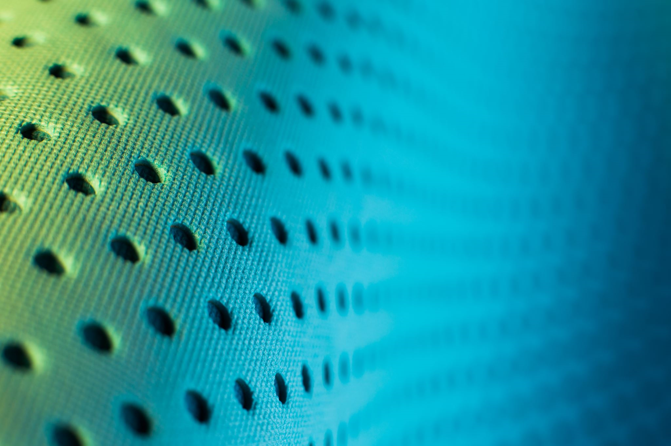
Dots and Dots of Fun: Weaving Braille into the Fabric of the Family.
Gail Gilchrist – Teacher of Students with Visual Impairments – Chilliwack, British Columbia, Canada.
Mary Anderson – Teacher of Students with Visual Impairments – Kamloops, British Columbia, Canada.

Slide 2
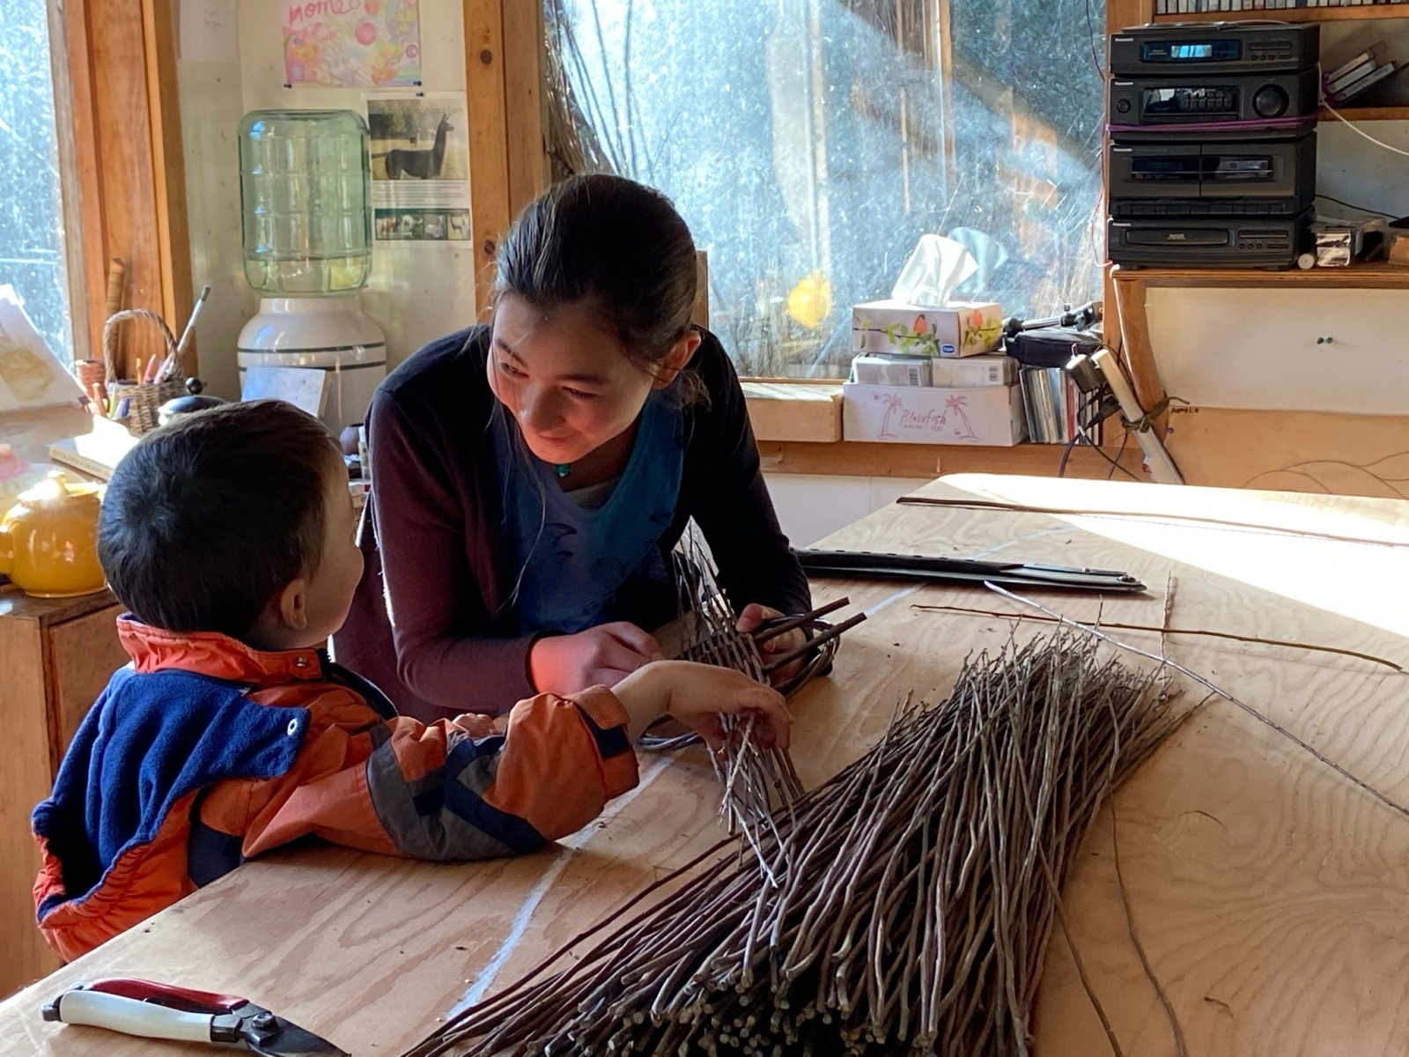
We wish to inspire ways of weaving braille into the fabric of the family.

Slide 3
Reading is an immersive experience that provides better comprehension, while listening is a passive activity with lower comprehension. Braille represents competency, independence, and equality. (Americanthermoform.com)

Slide 4
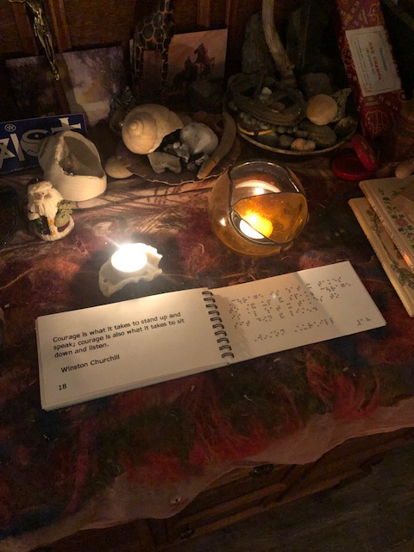
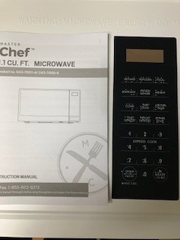
Braille in the Home

Slide 5
Brainstorm

Slide 6
Practical everyday ways of integrating braille into the family life
*Soundscapes
*Braille Games
*Braille Tales

Slide 7
Building Literary skills: Who? Where? When? What? Why? https://youtu.be/2pzxVvbHynU https://youtu.be/kxHmGn50nmk https://youtu.be/XxmZxM8AtUc
Soundscapes

Slide 8
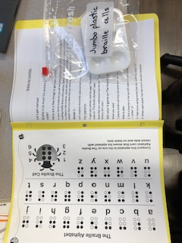
Family Braille Game - Dots and Dots of Fun

Slide 9
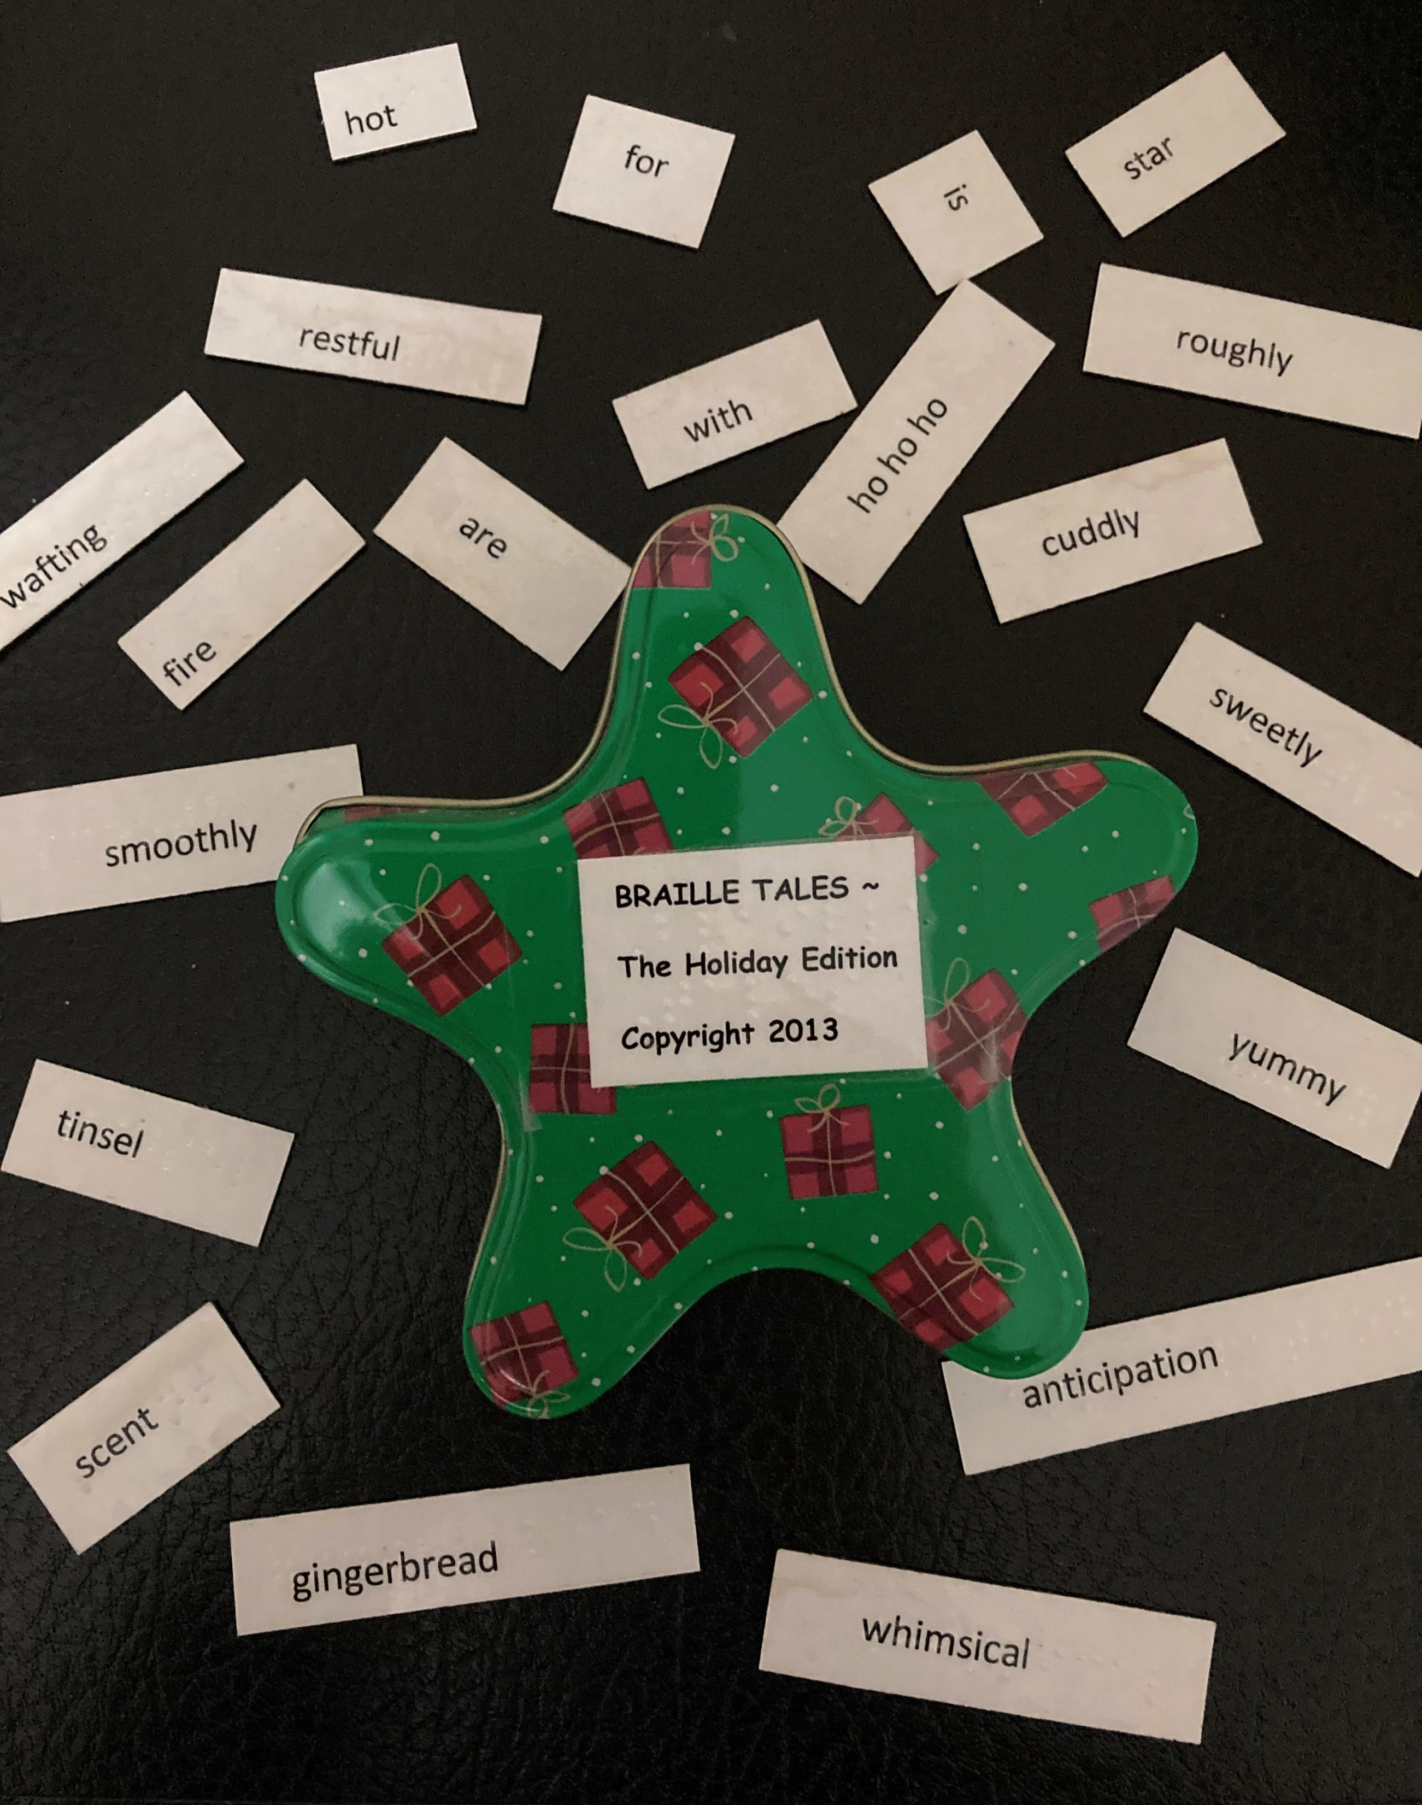
Braille Tales!
Add photo of Braille Tales here

Slide 10
“There is a wonder in reading braille that the sighted will never know: to touch words and have them touch you back.” ~ Jim Fiebig

Slide 11
Questions? Discussion, Feedback …

Slide 12
Soundscapes https://youtu.be/BkiSYhdJDQY https://youtu.be/Vg1mpD1BICI https://youtu.be/NXObT_Fl-xI https://youtu.be/B1tEh4aS8Wc https://youtu.be/kyu_SCEUPdI https://youtu.be/2pzxVvbHynU https://youtu.be/2T6bp0hjNBU https://youtu.be/UZ_RrLxMrEg https://youtu.be/kxHmGn50nmk https://youtu.be/XxmZxM8AtUc https://youtu.be/l7jAGNPOxAo https://youtu.be/VskbwXTRL7U https://www.perkins.org/four-reasons-why-braille-still-matters-in-the-age-of-alexa-and-iphone/
Resources/References

Slide 13
https://americanthermoform.com/why-read-braille-and-not-use-audio-books/ http://www.cnib.ca/en/living/braille/literacy/Default.aspx https://braillebug.org/wp-content/uploads/sites/6/2023/09/BrailleBugBrailleTrail.pdf https://www.ncbi.nlm.nih.gov/pmc/articles/PMC7382890/ https://www.tandfonline.com/doi/full/10.1080/10888438.2021.1969402 https://www.brailleliteracycanada.ca/en https://www.nbp.org/ic/nbp/about/aboutbraille/needforbraille.html# https://tspace.library.utoronto.ca/bitstream/1807/68673/1/Nadeem_Rooma_201506_MT_MTRP.pdf https://www.pathstoliteracy.org/resource/abc-braille-study-results-and-implications-teachers/
Resources/References (Continued)

